Slide 1
Mutable and Immutable Objects
Java Interlude 6
Data Structures and Abstractions with Java, 4e
Frank Carrano
© 2015 Pearson Education, Inc., Upper Saddle River, NJ. All rights reserved.

Slide 2
Mutable Objects
Consider classes we have studied that have private data fields and public methods that either look at or change these fields
  Such methods called accessor methods and mutator methods
An object that belongs to a class that has public mutator methods said to be mutable
© 2015 Pearson Education, Inc., Upper Saddle River, NJ. All rights reserved.

Slide 3
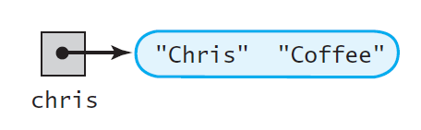
Mutable Objects
FIGURE JI6-1 An object and its reference variable chris
© 2015 Pearson Education, Inc., Upper Saddle River, NJ. All rights reserved.

Slide 4
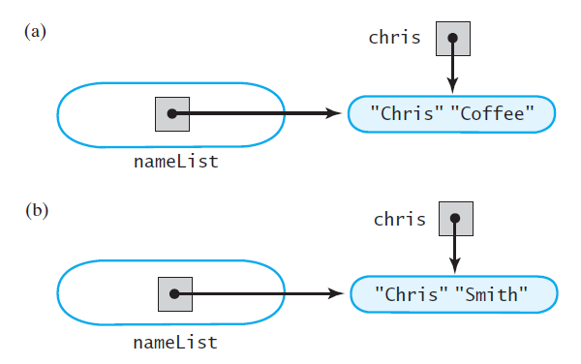
Mutable Objects
FIGURE JI6-2 An object in the list nameList (a) initially;
(b) after the reference variable chris is used to change it
© 2015 Pearson Education, Inc., Upper Saddle River, NJ. All rights reserved.

Slide 5
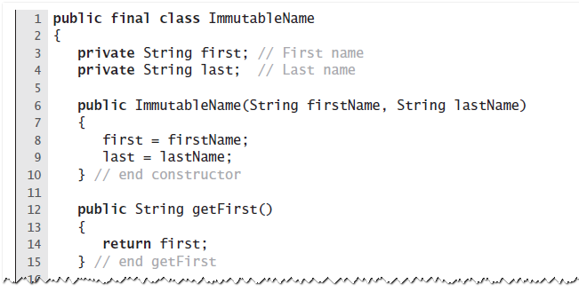
Creating a Read-Only Class
LISTING JI6-1 The read-only class ImmutableName
© 2015 Pearson Education, Inc., Upper Saddle River, NJ. All rights reserved.

Slide 6
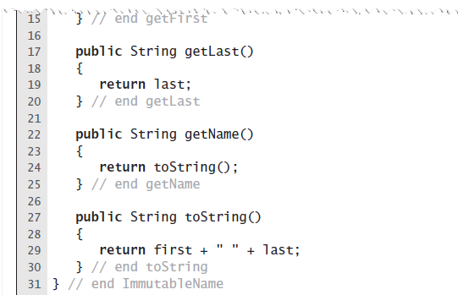
Creating a Read-Only Class
LISTING JI6-1 The read-only class ImmutableName
© 2015 Pearson Education, Inc., Upper Saddle River, NJ. All rights reserved.

Slide 7
Companion Classes
Sometimes we will want to represent an object in both immutable and mutable forms
  Companion classes can be convenient
Include constructors and/or methods that convert an object from one type to the other
© 2015 Pearson Education, Inc., Upper Saddle River, NJ. All rights reserved.

Slide 8
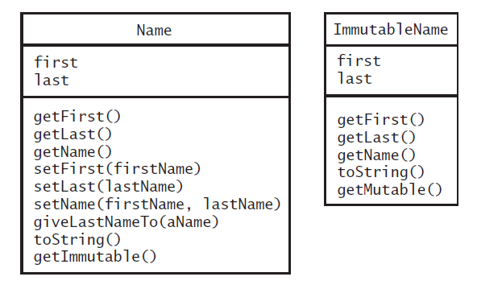
Companion Classes
FIGURE JI6-3 The classes Name and ImmutableName
© 2015 Pearson Education, Inc., Upper Saddle River, NJ. All rights reserved.

Slide 9
End
Java Interlude 6
© 2015 Pearson Education, Inc., Upper Saddle River, NJ. All rights reserved.

